Slide 1



DEFORESTATION(CLASSIFICATION OF FIRE TYPES)
SHAIK ABDUL RAZAK
STU65c7a68404a4b1707583108
INTERNSHIP_175040797468551b2636342

Slide 2

Learning Objectives
Understand MODIS satellite data structure and fire detection methodology.
Preprocess and analyze large-scale geospatial fire data from 2021–2023.
Perform EDA to identify patterns, distributions, and outliers in thermal anomaly data.
Train and evaluate ML models (e.g., Random Forest, XGBoost) to classify fire types.
Deploy a web app using Streamlit to predict fire types using satellite-derived parameters.
GOAL
Source :
www.freepik.com/

Slide 3
Tools and Technology used
Languages: Python
Libraries: pandas, seaborn, matplotlib, scikit-learn, XGBoost, folium
Platform: Streamlit
Data Source: NASA FIRMS MODIS Fire Detection Data (2021–2023)
Others: joblib (for model storage), Google Colab, folium (for geospatial visualization)

Slide 4
Methodology
Data Acquisition:
MODIS thermal anomaly/fire datasets for India from FIRMS (2021–2023).
Preprocessing:
Concatenation, cleaning, outlier removal (IQR), feature extraction (datetime, encoding).
EDA:
Visuals: heatmaps, count plots, histograms, box plots, scatter maps.
Insights on fire distribution, intensity, temporal patterns.
Modeling:
Models tried: Random Forest, KNN, Logistic Regression, XGBoost
Final model: Best accuracy with XGBoost + StandardScaler
Deployment:
Streamlit app for real-time prediction of fire types using six input features.

Slide 5
Problem Statement:
India experiences various fire events—forest fires, agricultural burns, and thermal anomalies. Challenge: Classify fire sources (vegetation, offshore, static land) from satellite signals to enable quicker response and environmental insights.

Slide 6
Solution:
Data-Driven Fire Classification System
Extracted fire attributes (brightness, FRP, confidence, etc.) from MODIS satellite data.
Applied EDA + ML pipelines to identify key patterns.
Built a real-time web app that takes fire parameters and predicts the type of fire using the trained model.
GIT LINK:
https://github.com/SHAIKRAZAK00/AICTE-IN.git

Slide 7
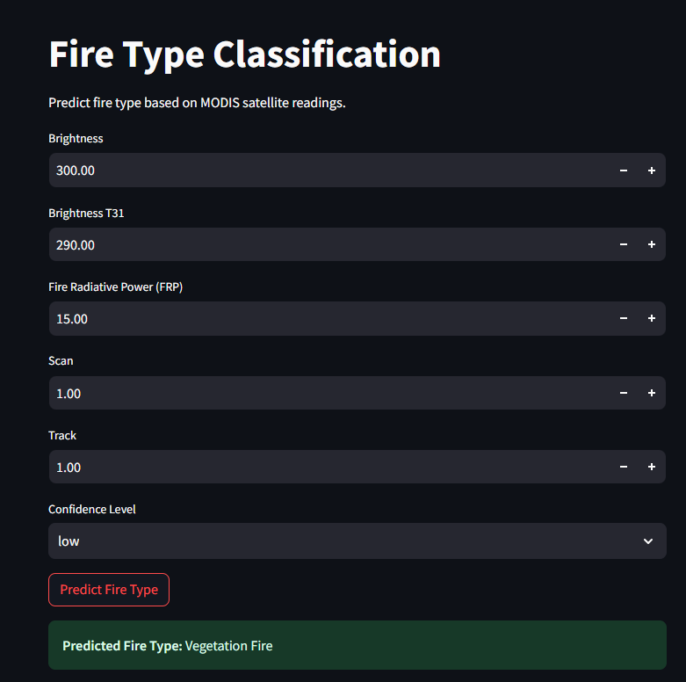
Screenshot of Output:

Slide 8
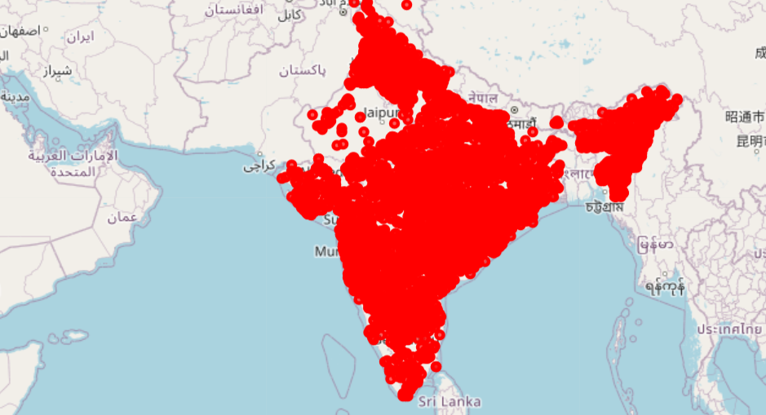
Screenshot of Output:

Slide 9
Conclusion:
Successfully built a classification model using real-world satellite data.
Achieved strong predictive performance across three fire types.
Deployed an interactive Streamlit app for practical usage.
Insights can help environmental agencies monitor fire incidents better.
Future work: Expand to global scale, include VIIRS + weather data for richer context.

